Slide 1


SAP S/4HANA CDS, RAP Training Day 5
Anubhav Oberoy

Slide 2

Agenda – Day 5
Understand OVP Fiori App
Use case to implement OVP
--break
Challenges in ABAP Development
Evolution to the ABAP programming language
RAP – Restful Application Programming
Definition of Business Object
Types of Implementation
BO Runtime lifecycle
Flight data model
Flow of development
Notes:
https://unsplash.com/photos/CPs2X8JYmS8

Slide 3

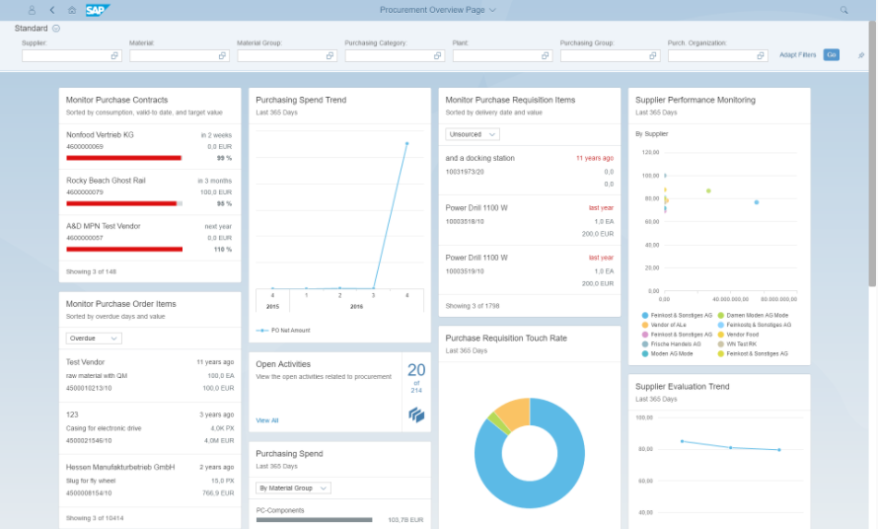
OVP Applications in S/4HANA
The overview page (OVP) is a data-driven SAP Fiori app type and floorplan that provides all the information a user needs in a single page, based on the user's specific domain or role.

Slide 4













Slide 5

































Slide 6



























Slide 7




Challenges in ABAP development
UI
Common needs
Create application logic
Insert, update, delete, validate, select data
Perform validations
Check customizing
Handle locks
Create A/c documents
Manage Documents
Application Code
I, U, D, S, V
Search Documents
Validate before save
Alex, ABAP Developer,
SAP FICO
UI
Challenges
Thinks differently
Adapt application code
High maintenance
No standardization
Different coding practices
Lack of standard
Create Sales Orders
Manage Sales Orders
Application Code
I, U, D, S, V
Search/Filter Sales Order
Compute Sales total
Stella, ABAP Developer,
SAP SD
Trainer: Anubhav Oberoy

Slide 8
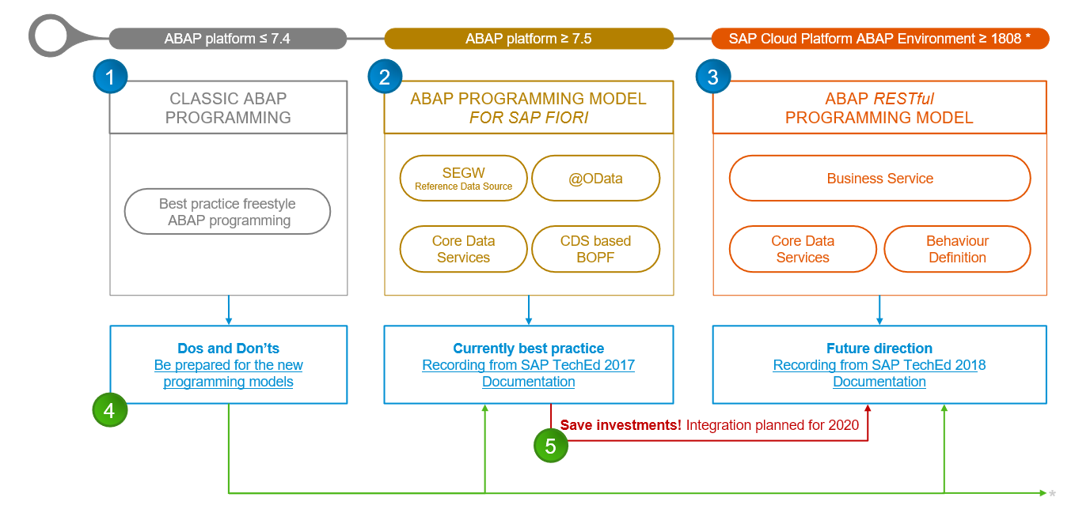
Evolution of ABAP Programming Model

Slide 9
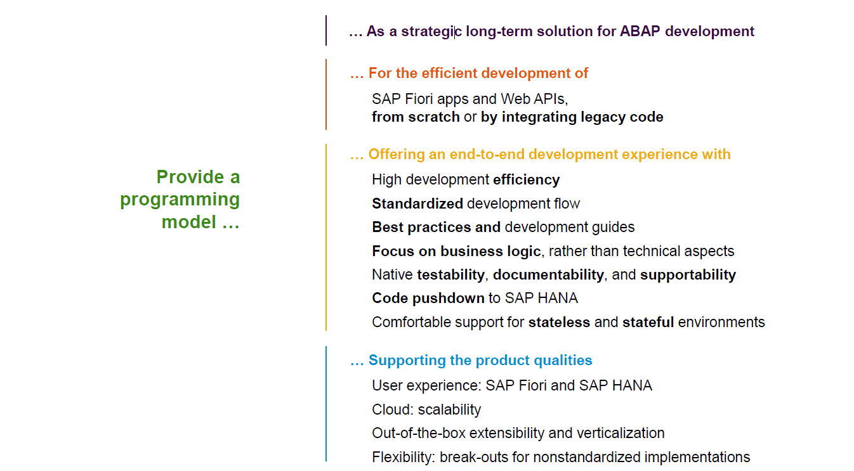
Restful ABAP Programming

Slide 10
Restful ABAP Programming
The ABAP RESTful programming model defines the architecture for efficient end-to-end development of intrinsically SAP HANA-optimized OData services (such as Fiori apps) in SAP Business Technology Platform ABAP Environment. It supports the development of all types of Fiori applications as well as A2X services. It is based on technologies and frameworks such as Core Data Services (CDS) for defining semantically rich data models and a service model infrastructure for creating OData services with bindings to an OData protocol and ABAP-based application services for custom logic and SAPUI5-based user interfaces .
The whole architecture is based on
CDS views – will helps you to create semantically rich data model.
Business Object here is a node inside a tree data structure which is achieved by using root keyword at CDS view level, this is needed only if we want to add transactional capability.
Finally create a service using service definition and service binding .
The binding will confirm the Purpose of service – API or Fiori.
UI layer with the Fiori app using elements.

Slide 11

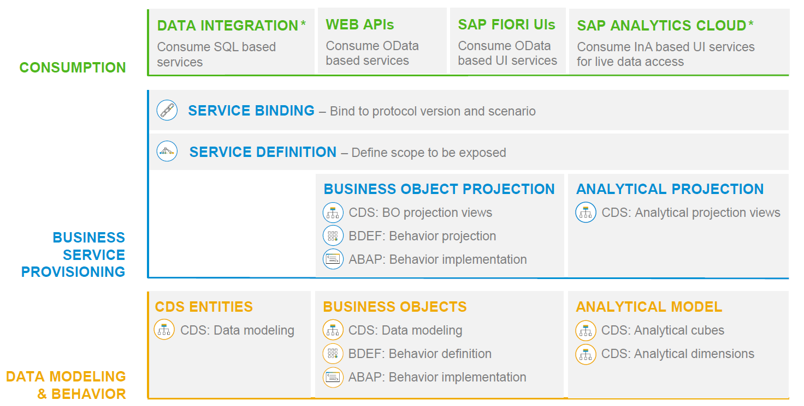
RAP – The Big picture

Slide 12
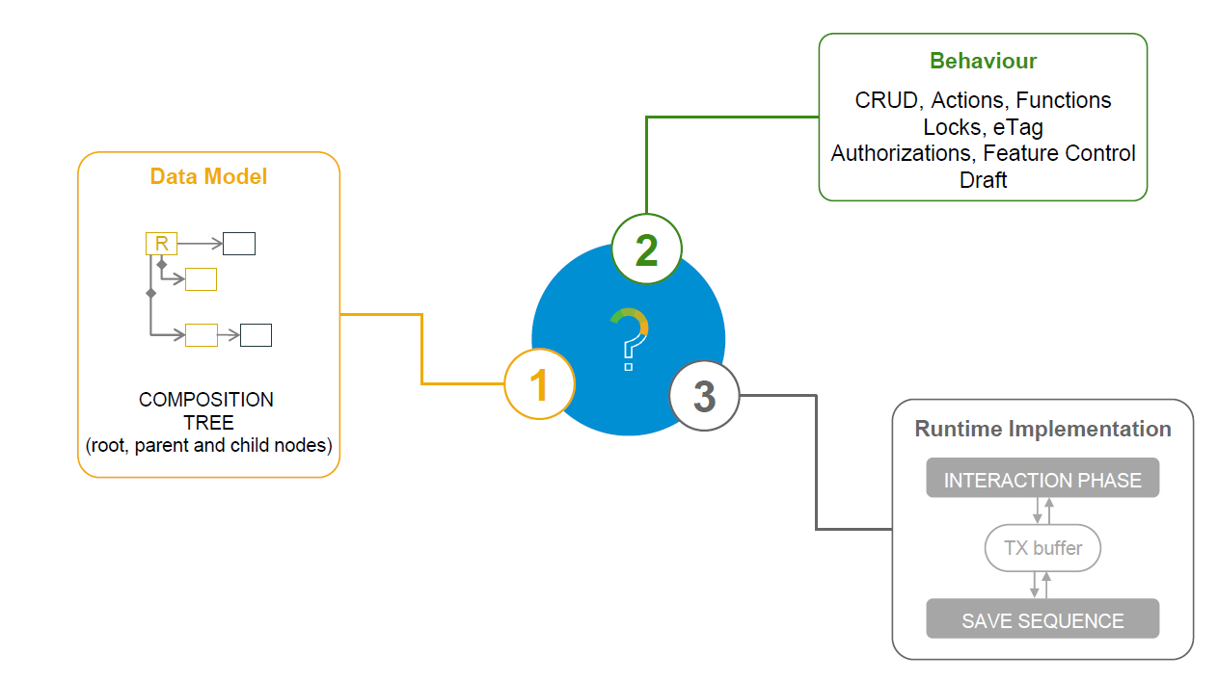
What is a Business Object

Slide 13
Types of Implementation (Scenario)
Brownfield Implementation
Is used when we want to create a transactional application which can insert, update, delete data from the system by writing your own logic
You already have Business logic with you and you want to use that business logic to perform transactional capability
You are own your own to manage your implementation.
02. Managed Scenario
Greenfield Implementation
Is used when we want to create a transactional application which can insert, update, delete data from the system by using the framework provided implementation
You do not have Business logic with you and you want system to create business logic for you automatically.
01. Un-Managed Scenario

Slide 14
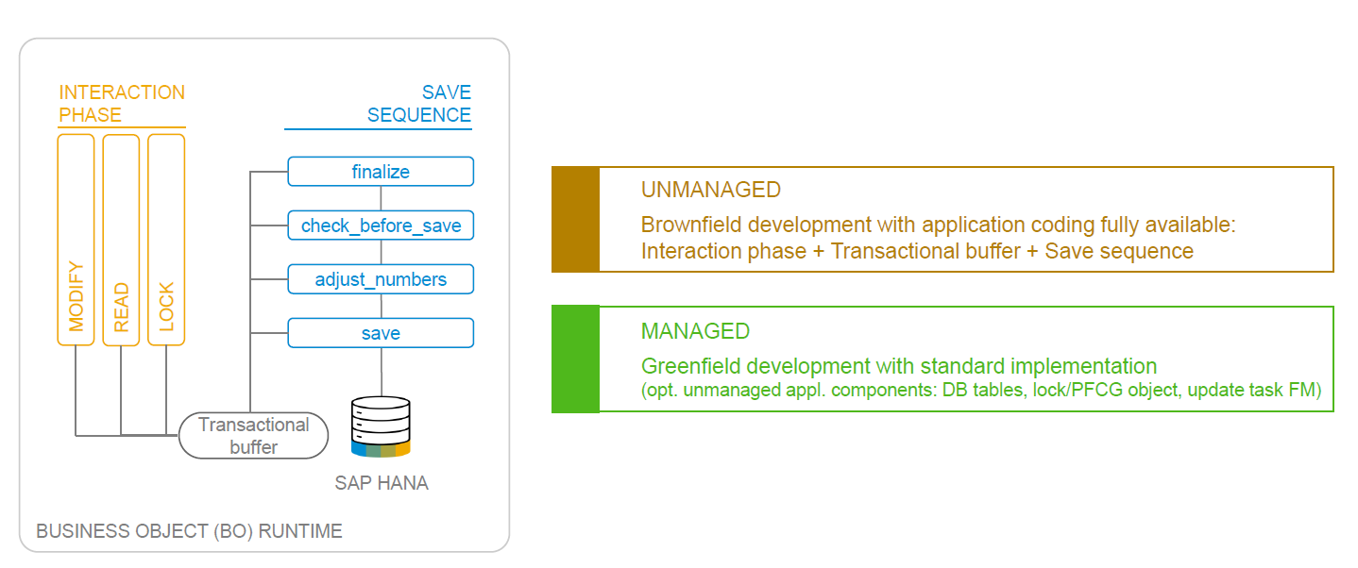
BO runtime implementation types

Slide 15
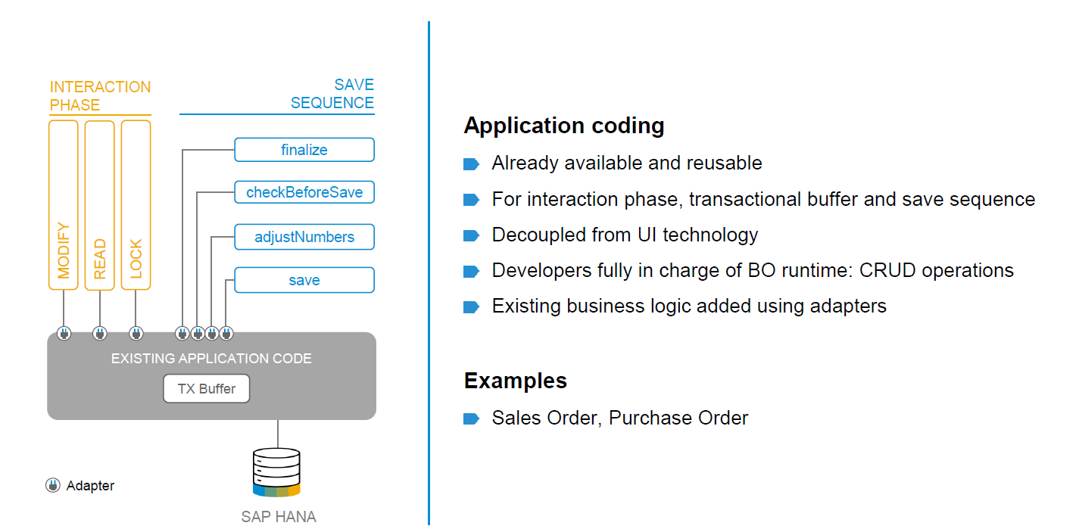
BO runtime implementation types

Slide 16

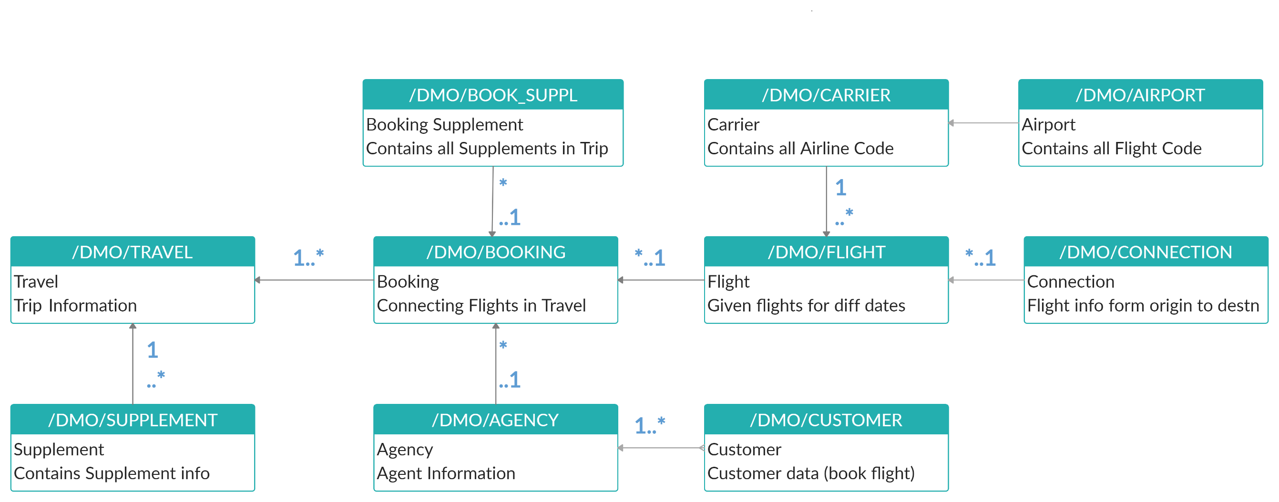
Explanation of Flight Data Model
If Data is not found in these Table’s please execute Data Generator Class “/dmo/cl_flight_data_generator”

Slide 17
Flow of Development (Unmanaged Scenario)
Fiori UI
Service Binding for UI
Service Definition
Travel – Using /demo/travel
Projection view- what we want to show to UI
1
N
I_Currency
1
N
N
Agency
Customers
I_Country

Slide 18
Title
Text

Slide 19
Title
Text

Slide 20

Questions?

Slide 21

Thank you
Anubhav.abap@gmail.com
contact@anubhavtrainings.com
+91 84484 54549
www.anubhavtrainings.com

